Slide 1

Trips&Travel.com
Holiday Package Recommendation
By Power Rangers

Slide 2
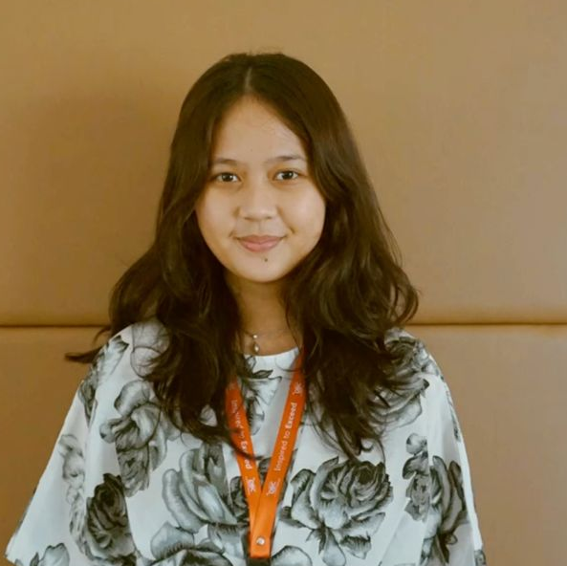
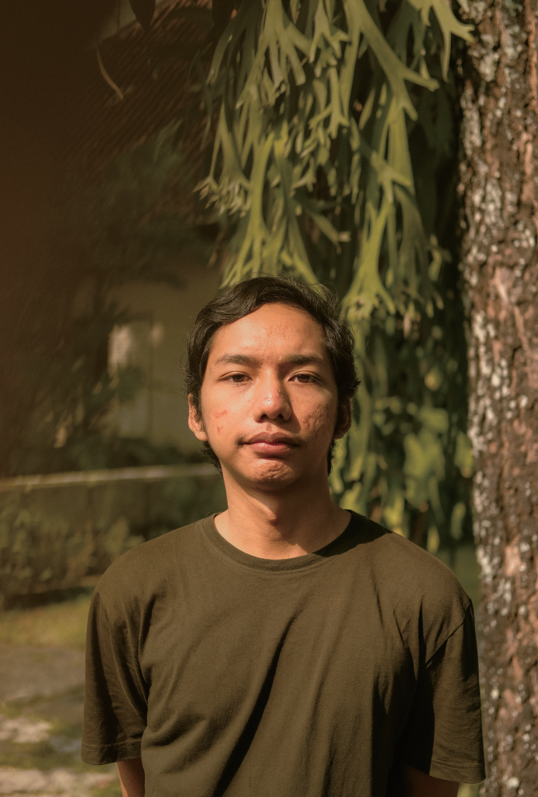
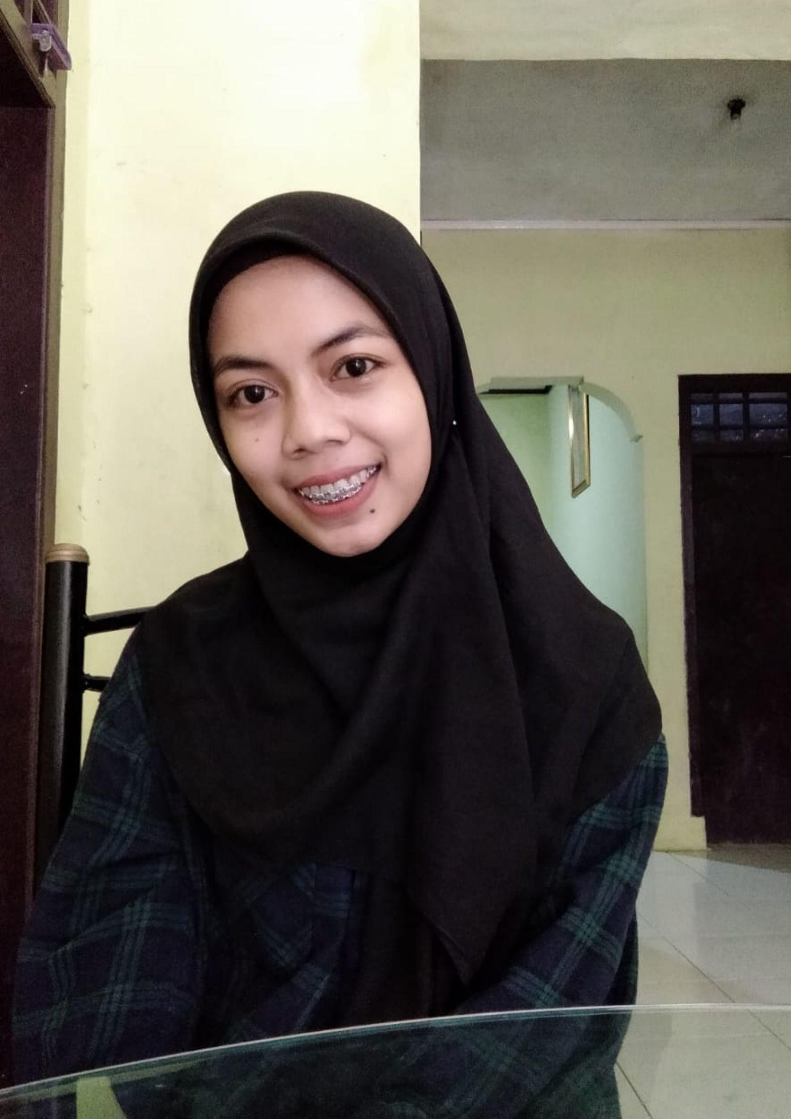

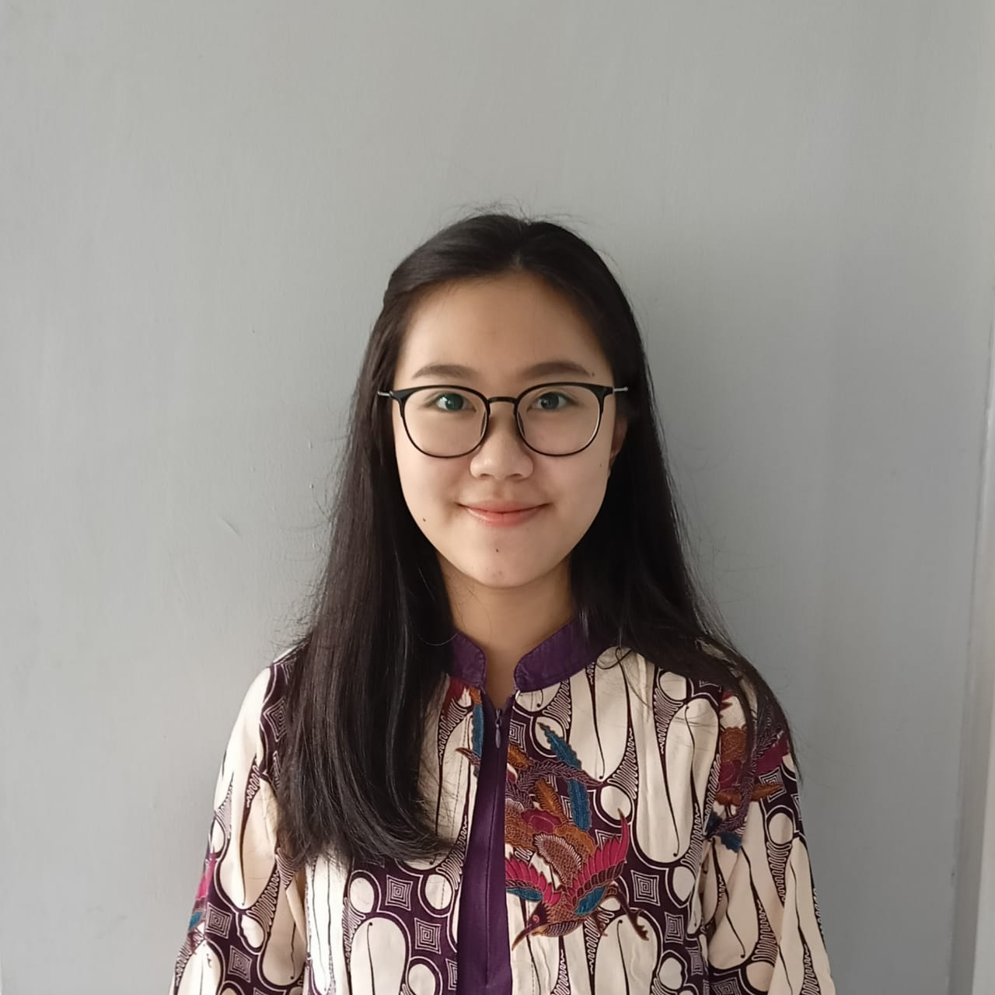
Our Team
Data Scientist
Dwirany Dian Audry
Talenta Nanda
Mega Dwi Astuti
Business Team
By Power Rangers
Ichwan
Avinska Valeria

Slide 3
Table of Contents
01
02
Project Background
Data Preparation
03
04
Modeling
Business Recommendation
By Power Rangers

Slide 4


Project Background
01

Slide 5



Trips & Travel.Com
is a company that provides holiday packages such as: Basic, Standard, Deluxe, Super Deluxe, King
Looking at the data of the last year, the marketing cost is quite high while only 18% of the customers purchased the packages. They loss 3.968 customers because customers were contacted randomly
18%
Taken Product
82%
Not taken product
Project Background

Slide 6
Problem Statement
Goal
82% customer not taken holiday packages because they were contacted randomly
Increase sales of Trips & Travel.Com Holiday Packages
Objectives
Create system to predict potential customer to support Wellness Tourism Package sales
Determine customer segmentation of the available packages
Implement new marketing strategies
Project Background

Slide 7


Data Preprocessing
02

Slide 8




Dataset
Customer Profile
Feature
Target
Business Metrics
Number of Product Taken Revenue
CustomerID
Age
CityTier
Occupation
Gender
PreferredPropertyStar
MaritalStatus
Passport
OwnCar
Designation
MonthlyIncome
TypeofContact
DurationofPitch
NumberofPersonVisiting
NumberofFollowups
ProductPitched
NumberofTrips
PitchSatisfactionScore
NumberofChildrenVisiting
ProdTaken
Data Preproccessing

Slide 9
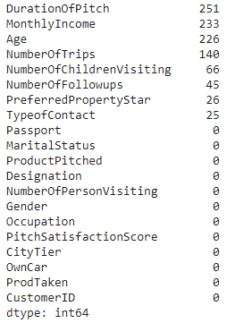
Missing Value
Feature Selection
Preferred Property
Gender
Duration of Pitch
Number of trips
Number of follow up
Pitch Satisfaction
Type of Contact
Product Pitch
Designation
Passport
City Tier
Marital status
Occupation
Monthly Income
Age
Handle null values:
with mean
Age
MonthlyIncome
DurationOfPitch, NumberOfTrips
with mode
NumberOfFollowups
PreferredPropertyStar
NumberOfChildrenVisiting
TypeofContact
Data Preproccessing

Slide 10
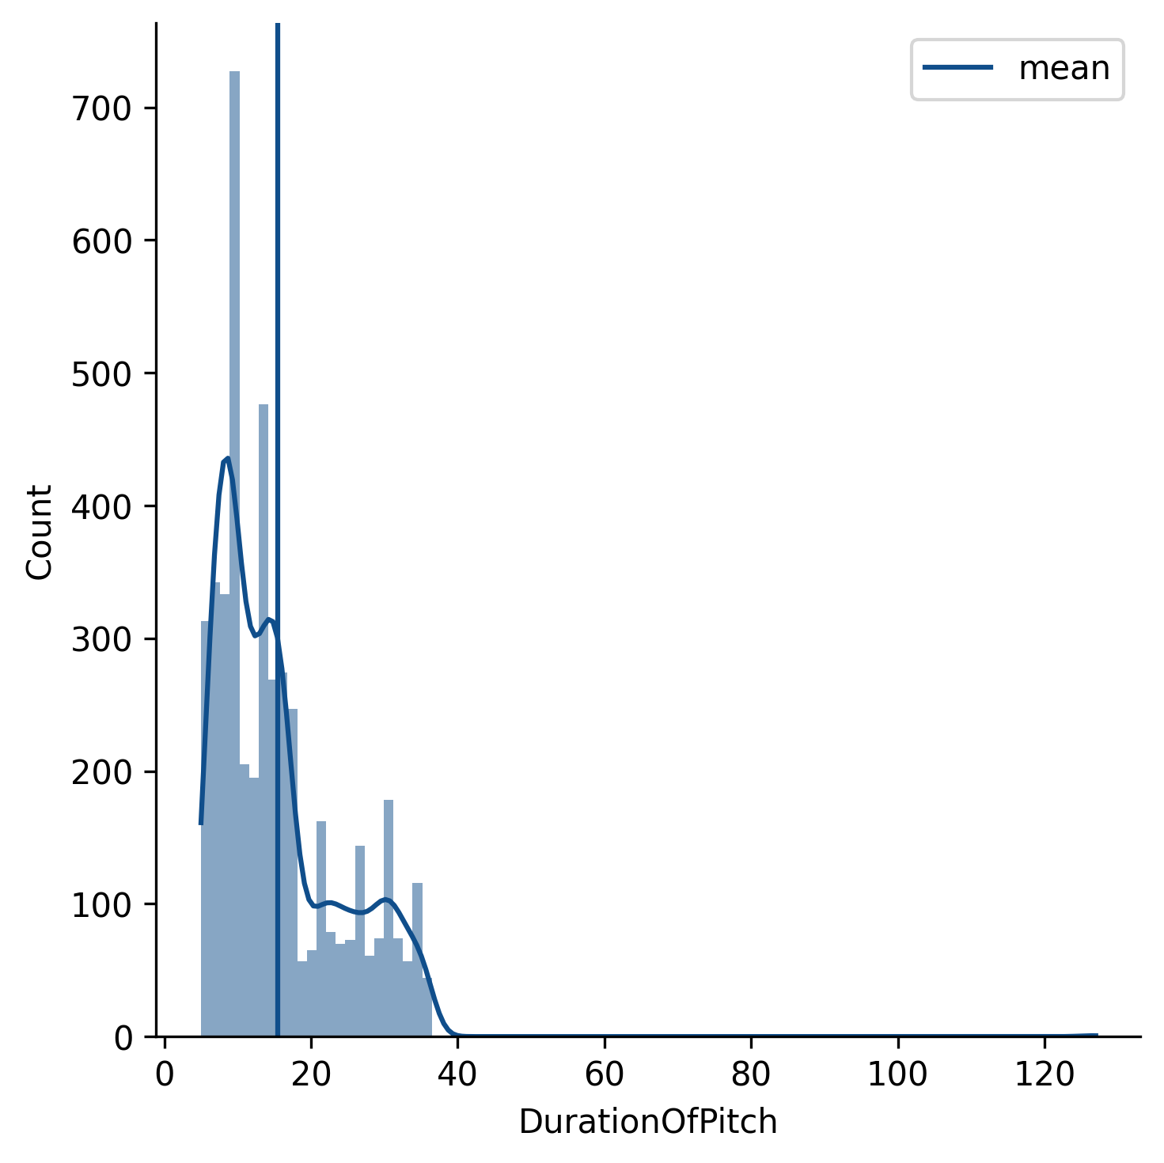
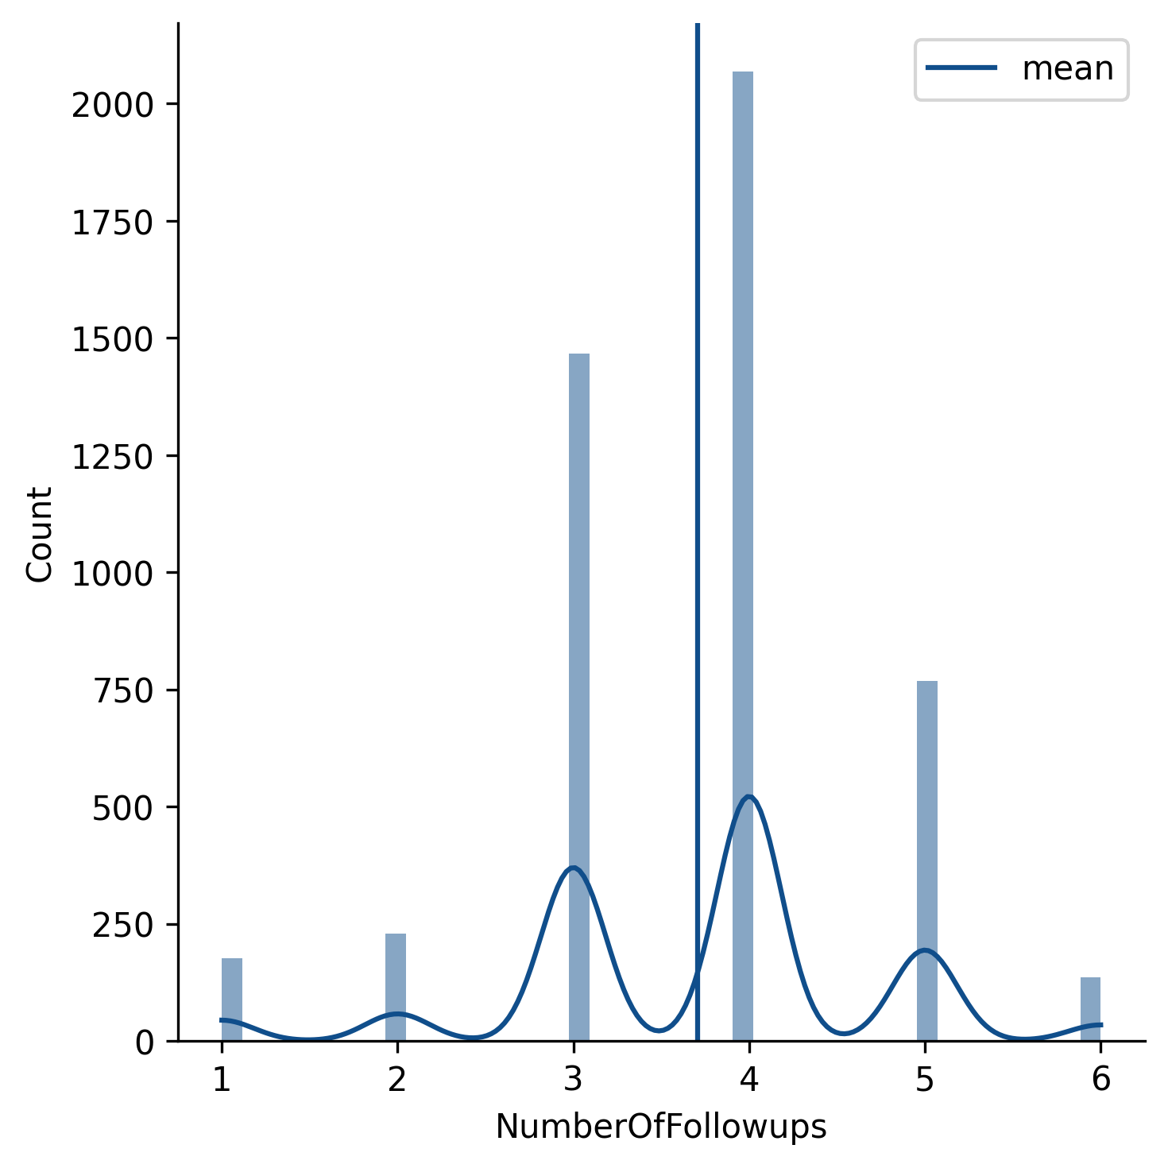
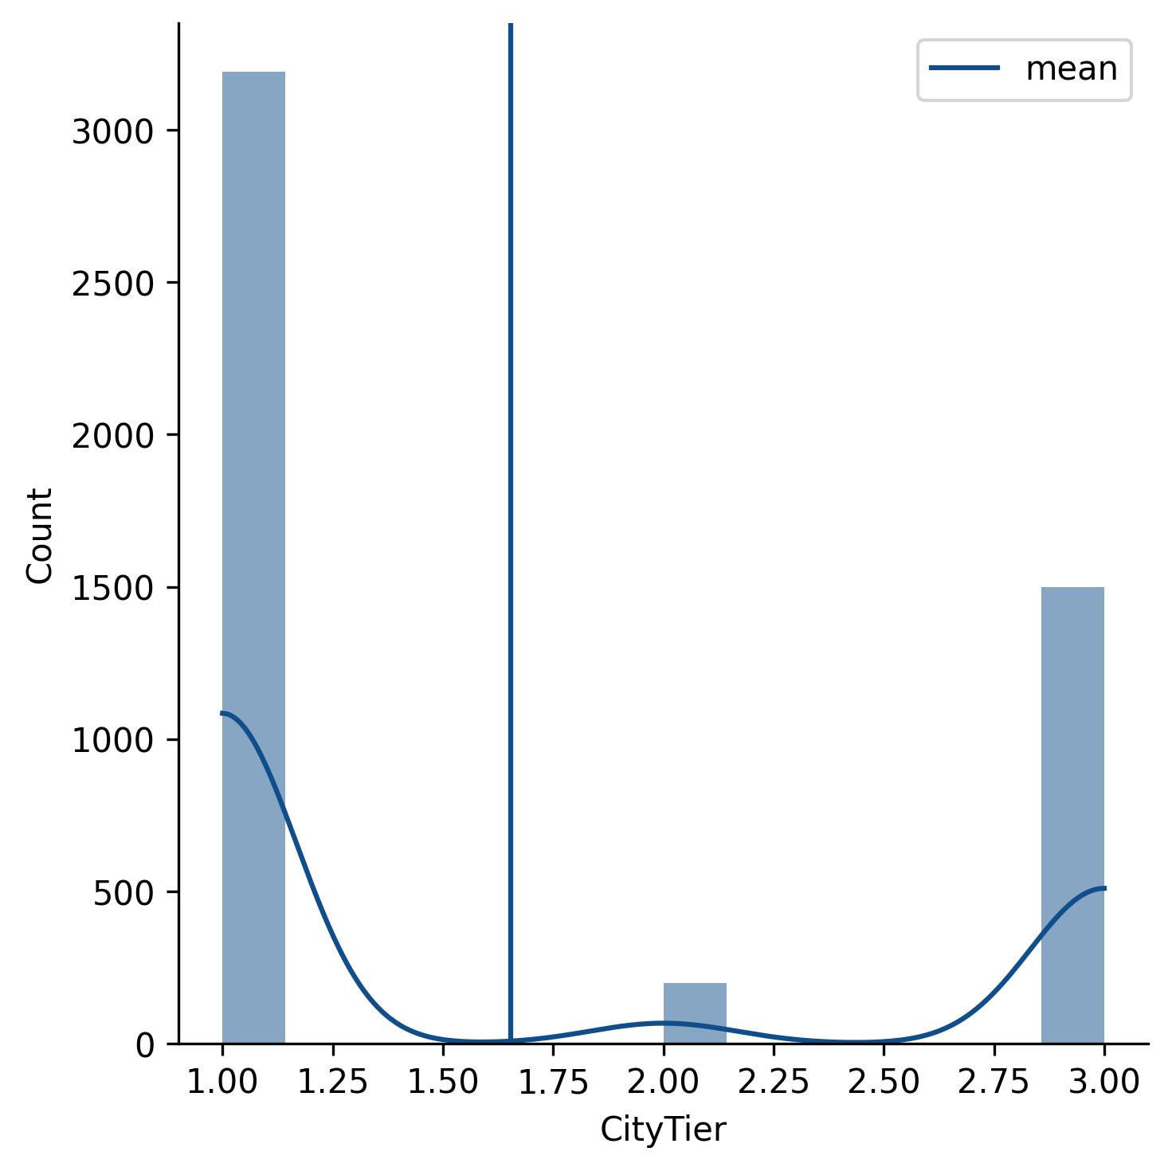
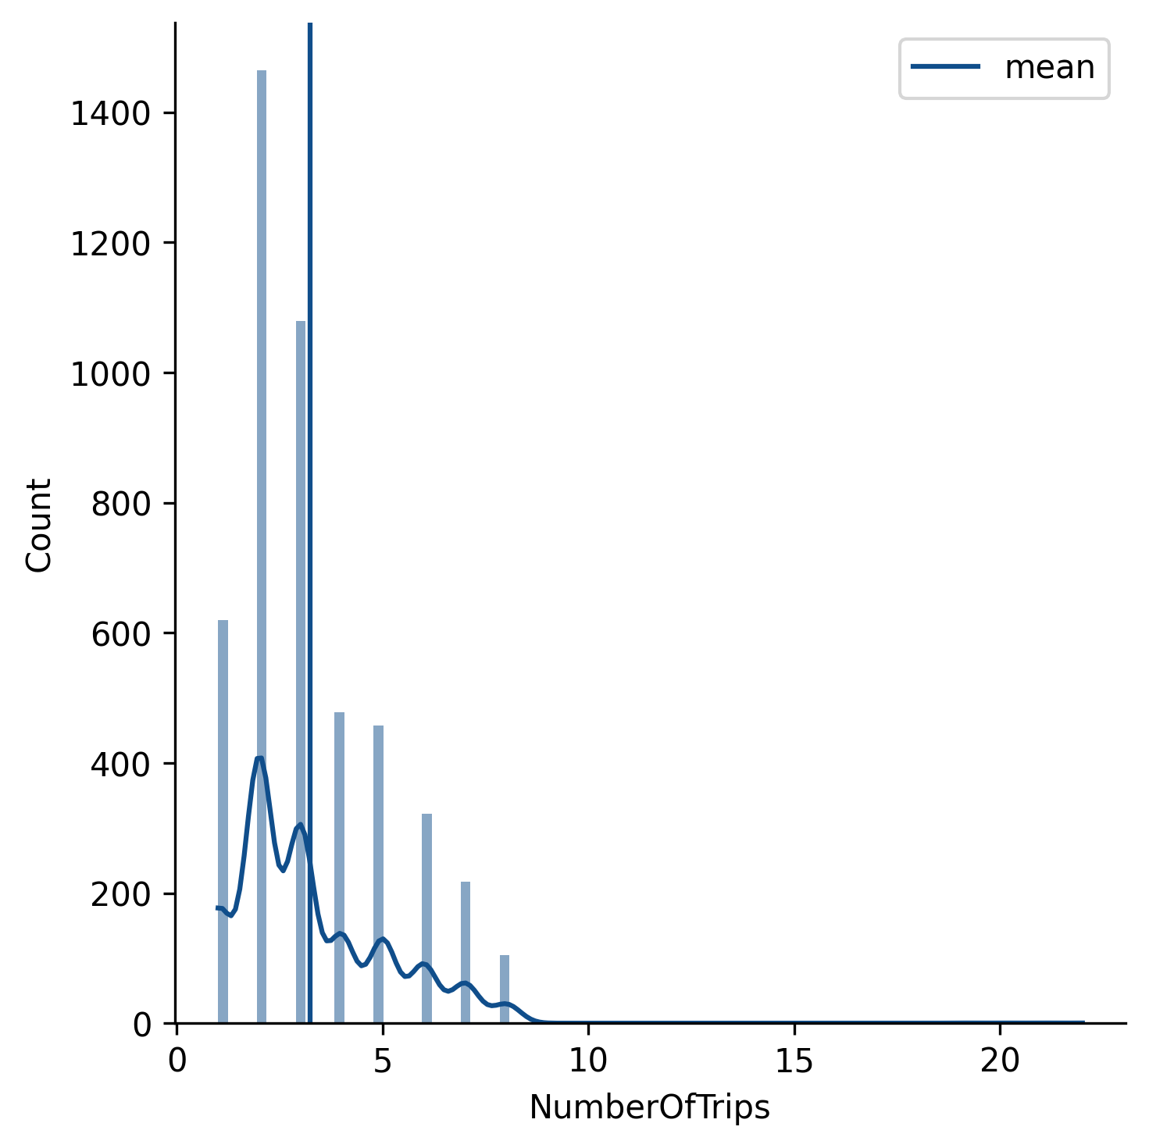
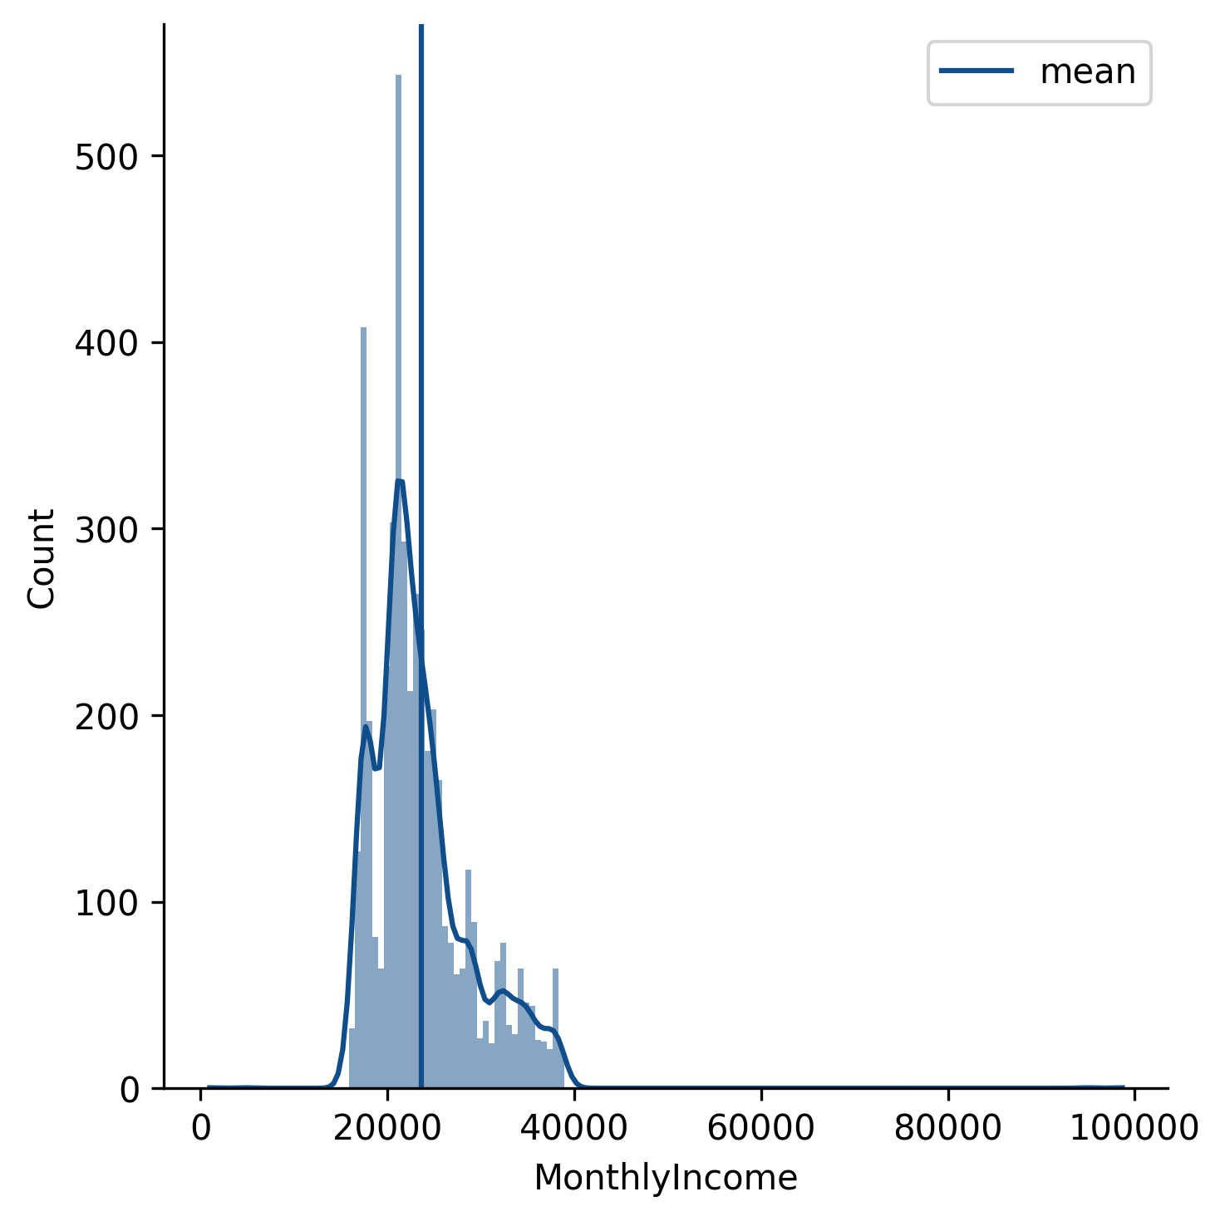
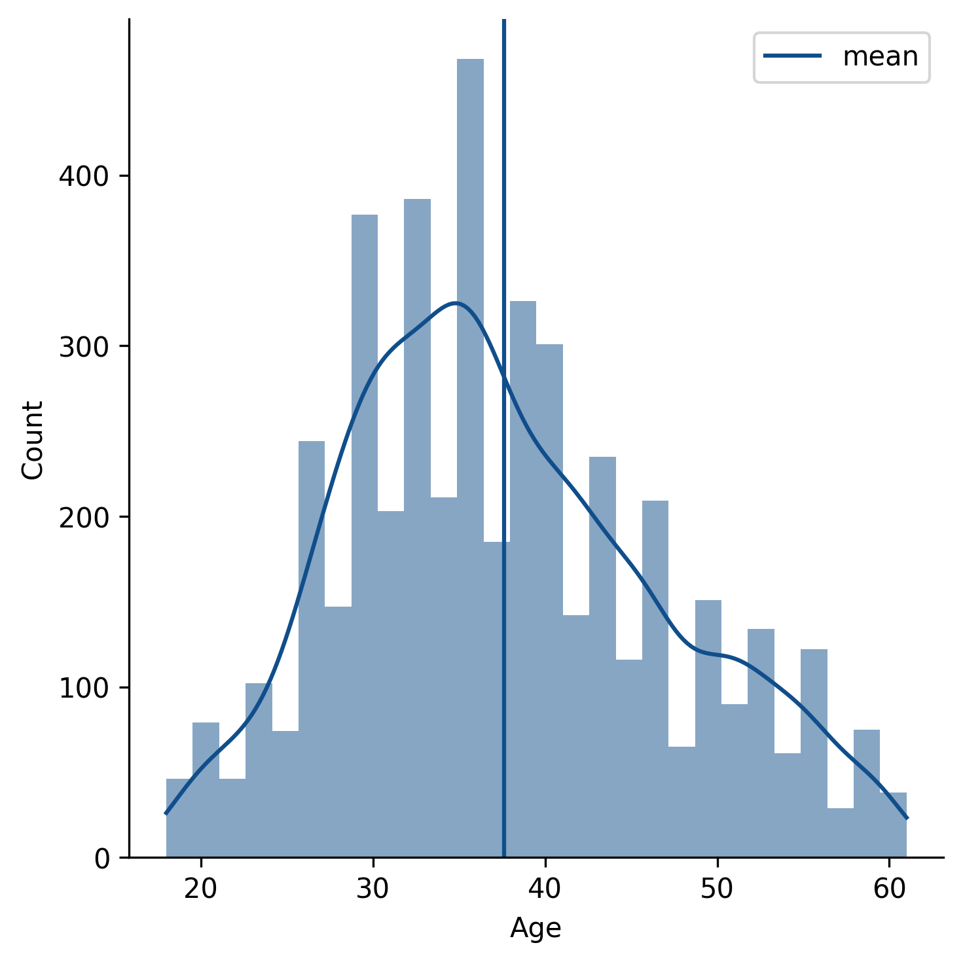
Data Distribution - Before Normalization & Handle Outliers
Data Preproccessing

Slide 11
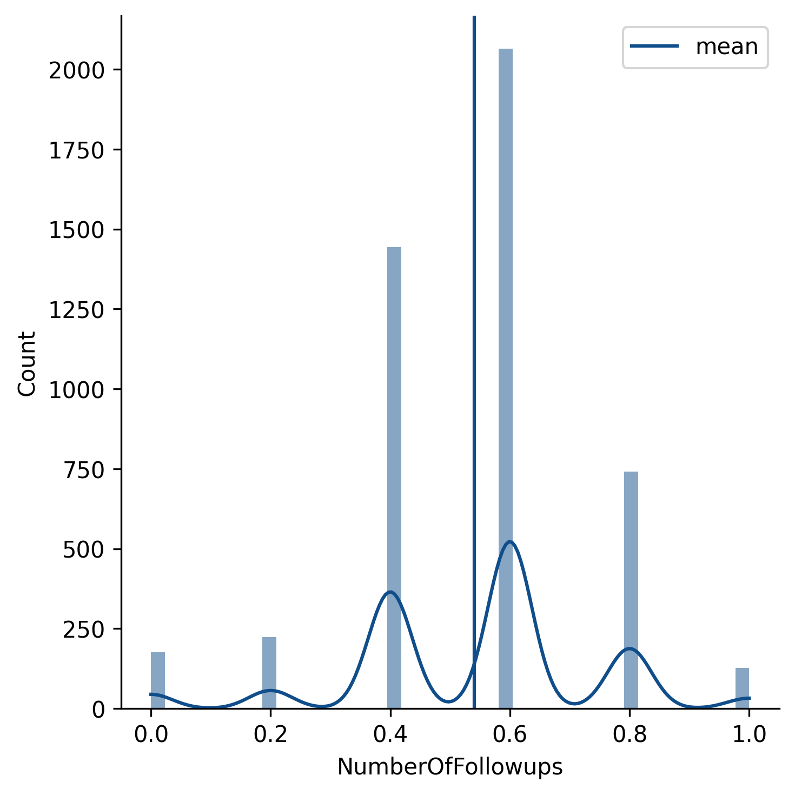
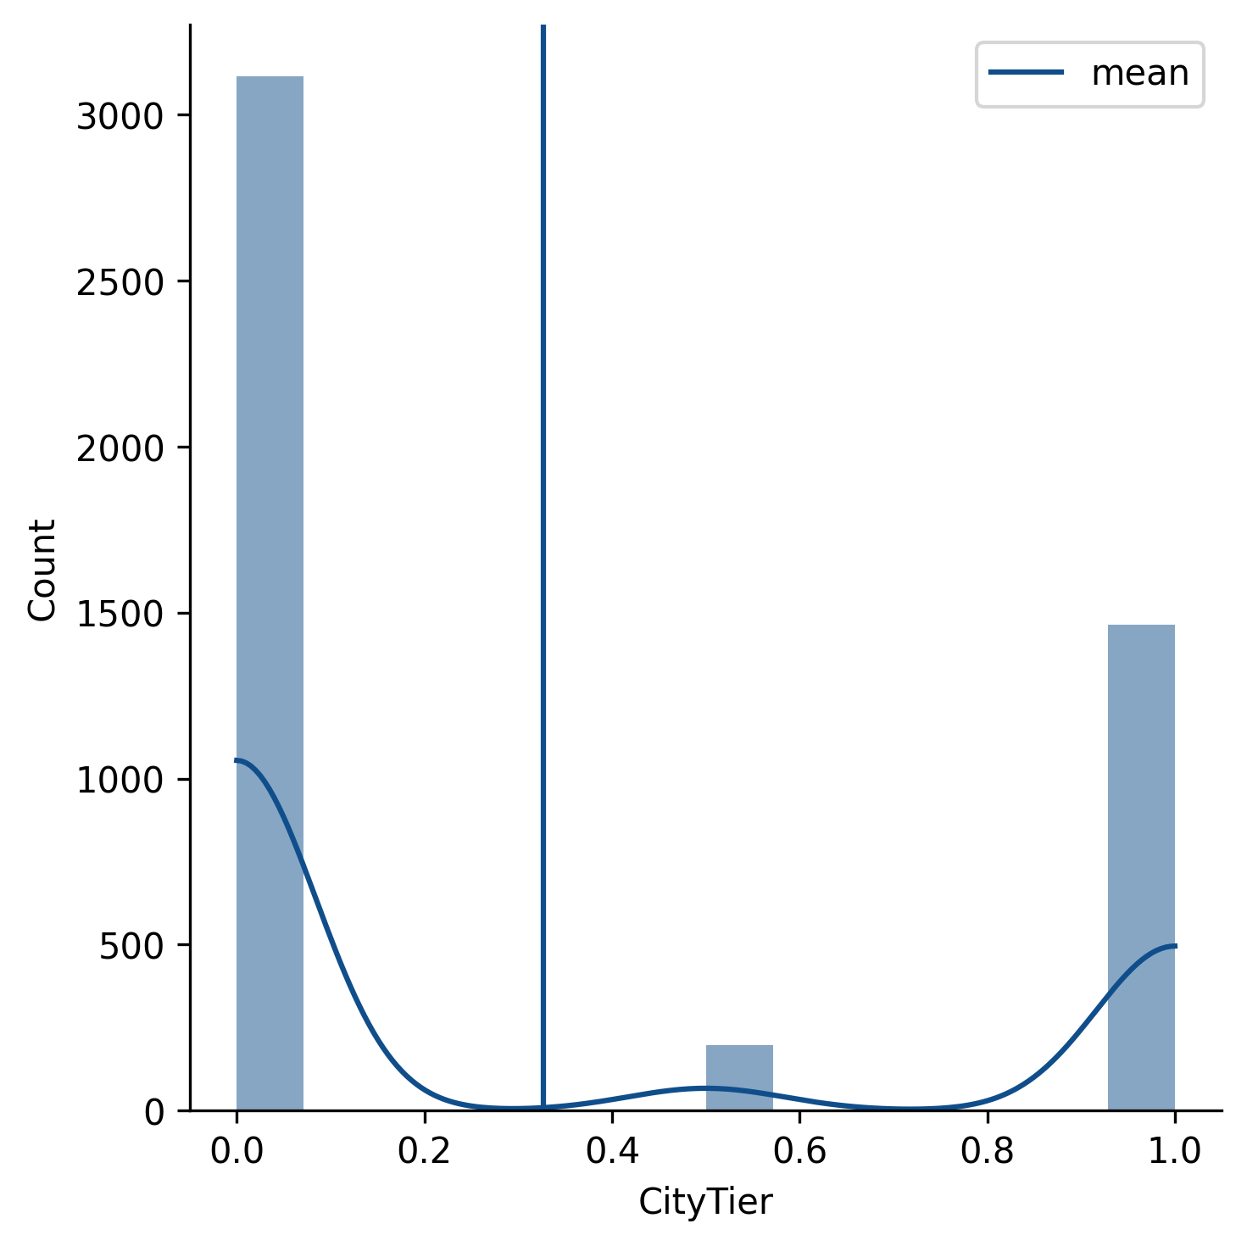
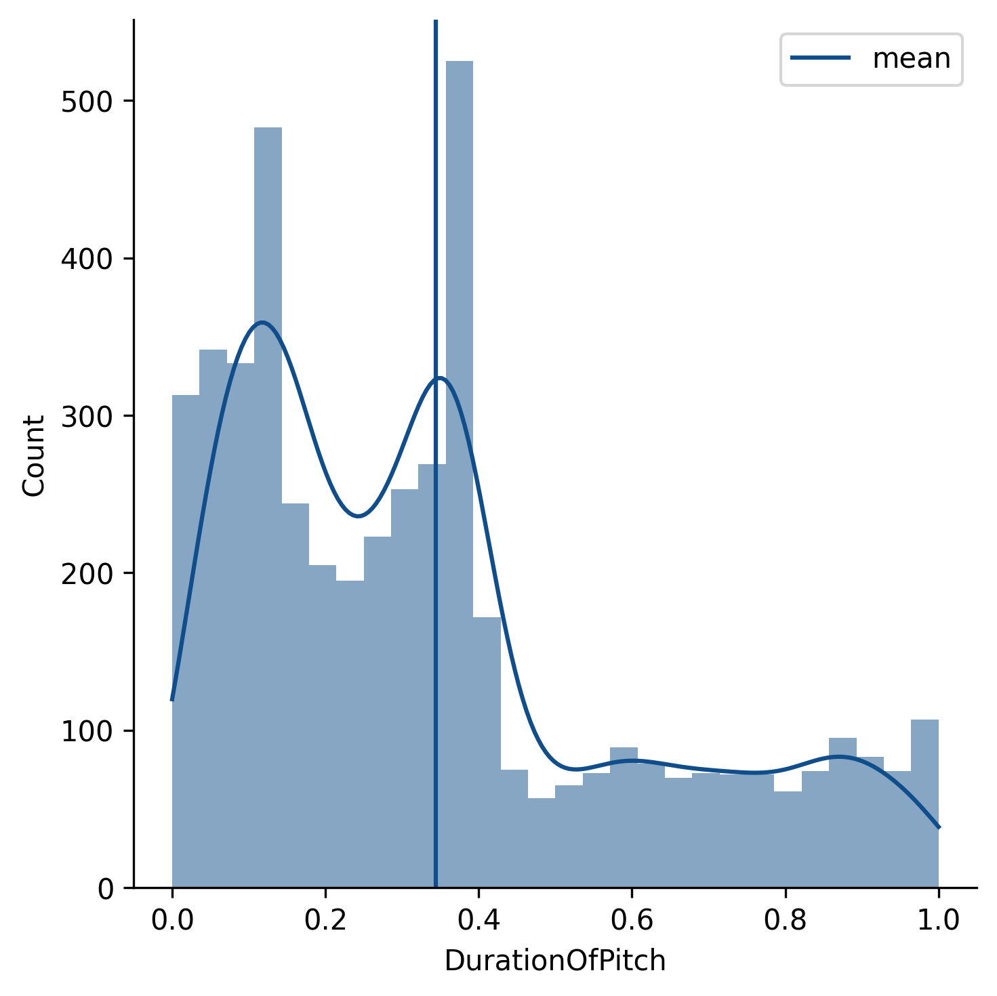
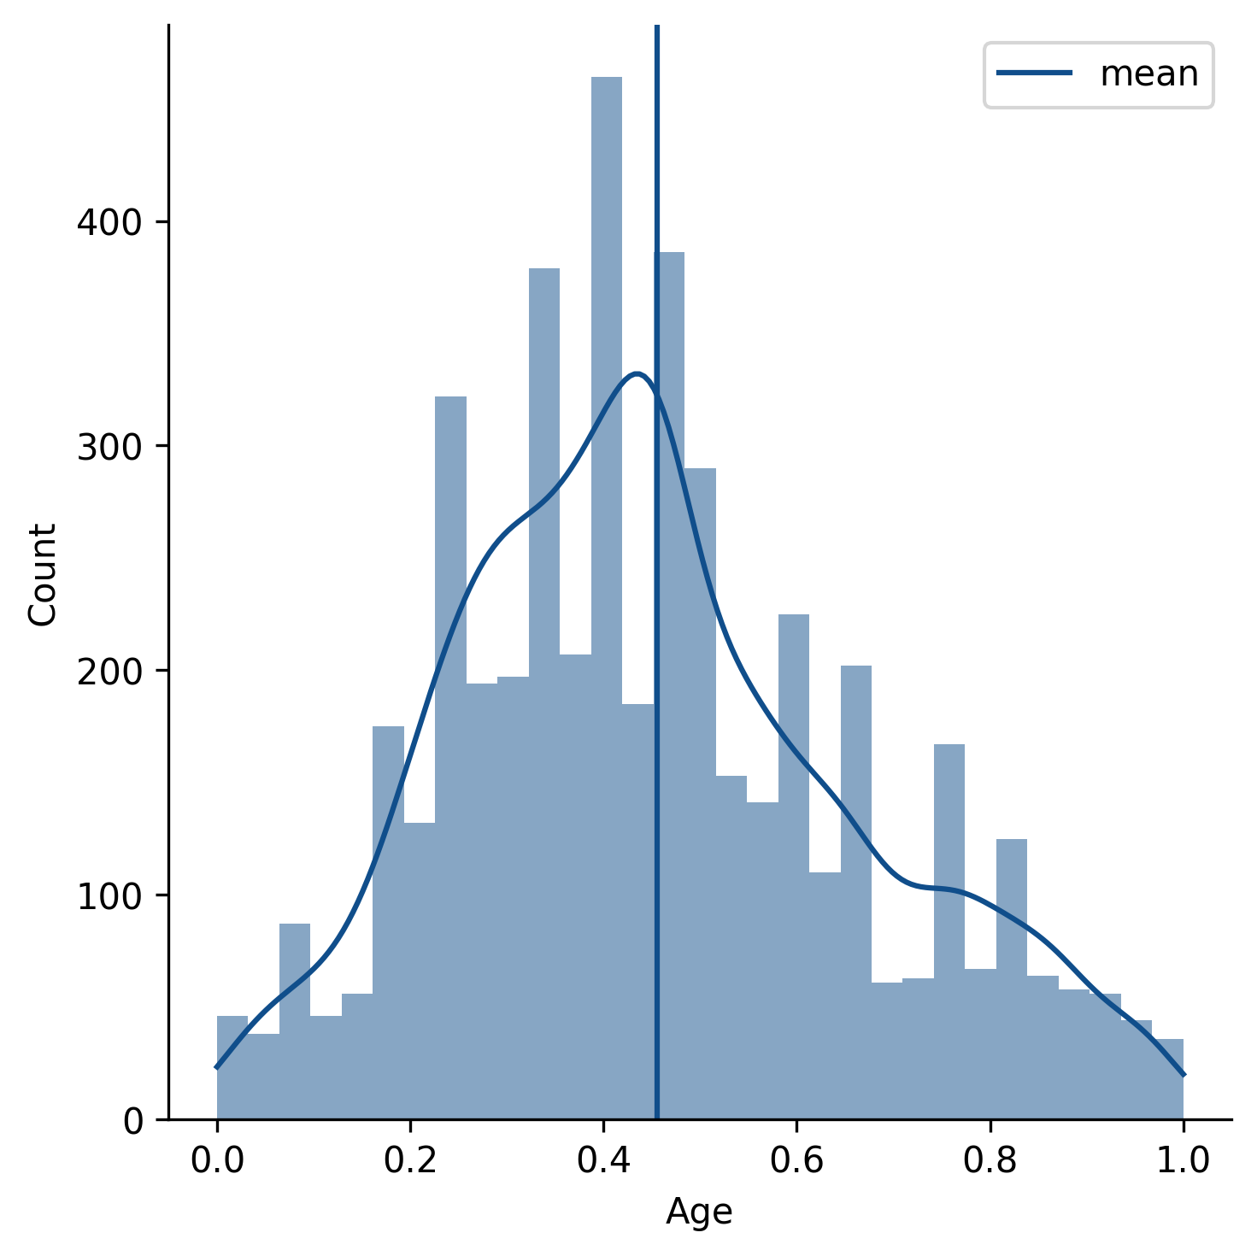
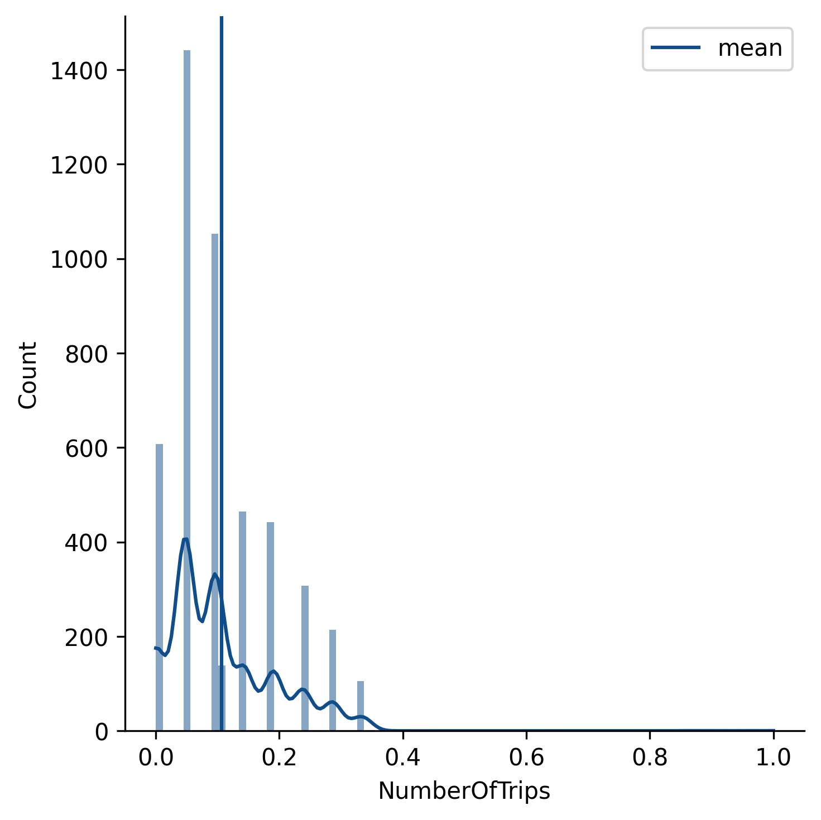
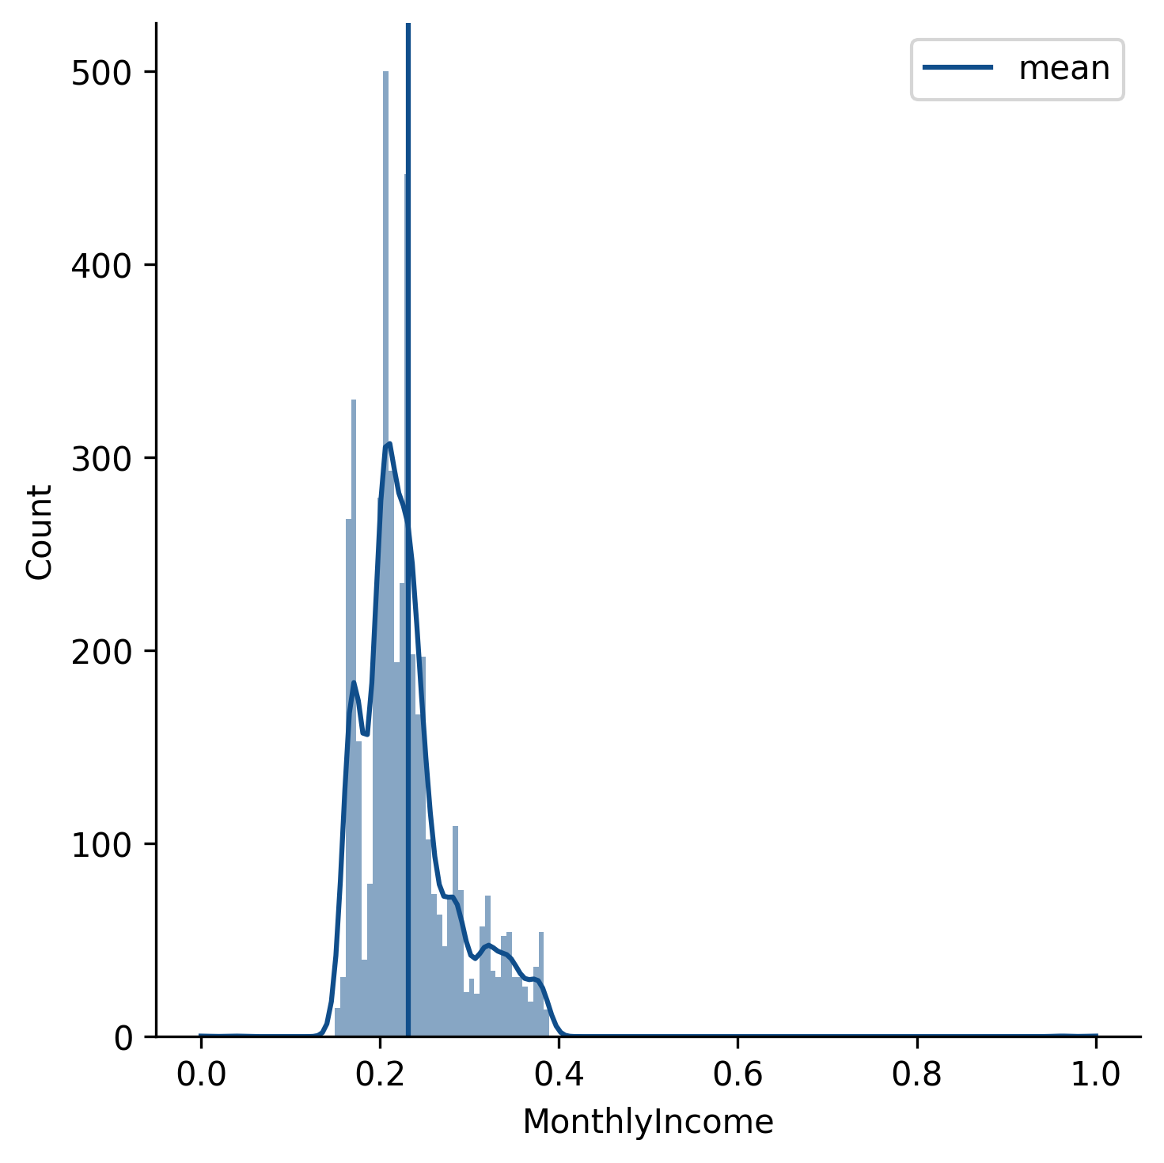
Data Distribution - After Normalization & Handle Outliers
Data Preproccessing

Slide 12
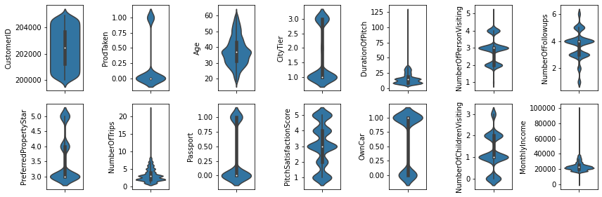
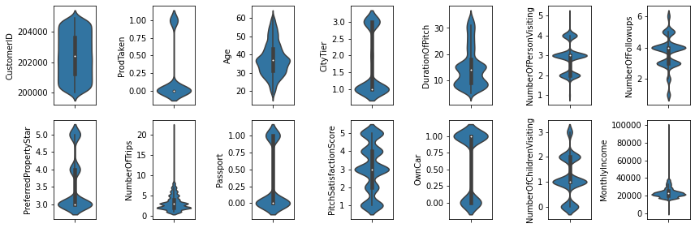
Outliers
Handle Outliers
Normalization
Transform skewed distribution feature’s value into the same scales with MinMaxScaler
Handle outliers on DurationOfPitch with IQR Method because we assume the number is not necessary, while on MonthlyIncome & NumberfTrips are valid
Feature Engineering
Data Preproccessing
Label encoding on Gender and hot encoding on Occupation, MaritalStatus and Designation

Slide 13
Data Insight
* Data terlihat valid dan tidak ada kecacatan
* Namun masih ada data-data yang kosong/hilang, harus diurus ketika preprocessing
* Ada beberapa distribusi yang sedikit *skewed*, hal ini harus diingat apabila kita ingin melakukan sesuatu atau menggunakan model yang memerlukan asumsi distribusi normal
* Beberapa *feature* memiliki korelasi yang jelas dengan *target*, mereka akan dipakai
* Beberapa *feature* terlihat sama sekali tidak berkorelasi, mereka sebaiknya diabaikan
* Ada feature yang korelasinya tinggi satu sama lain (berat/tinggi) mungkin cuma akan dipakai satu
Data Preproccessing

Slide 14
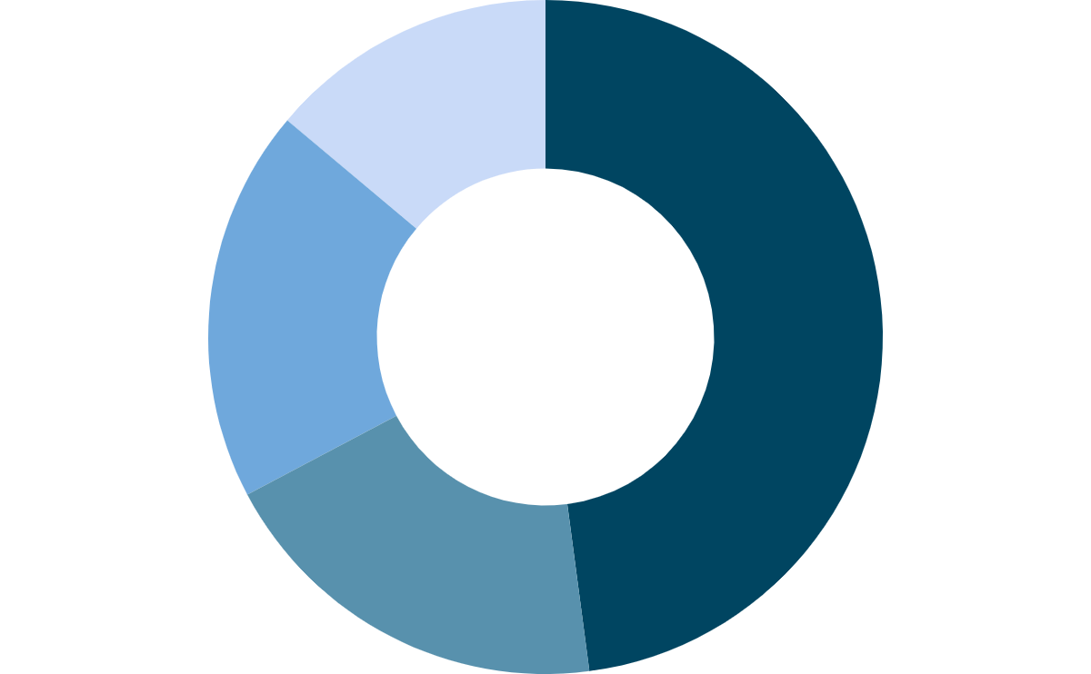
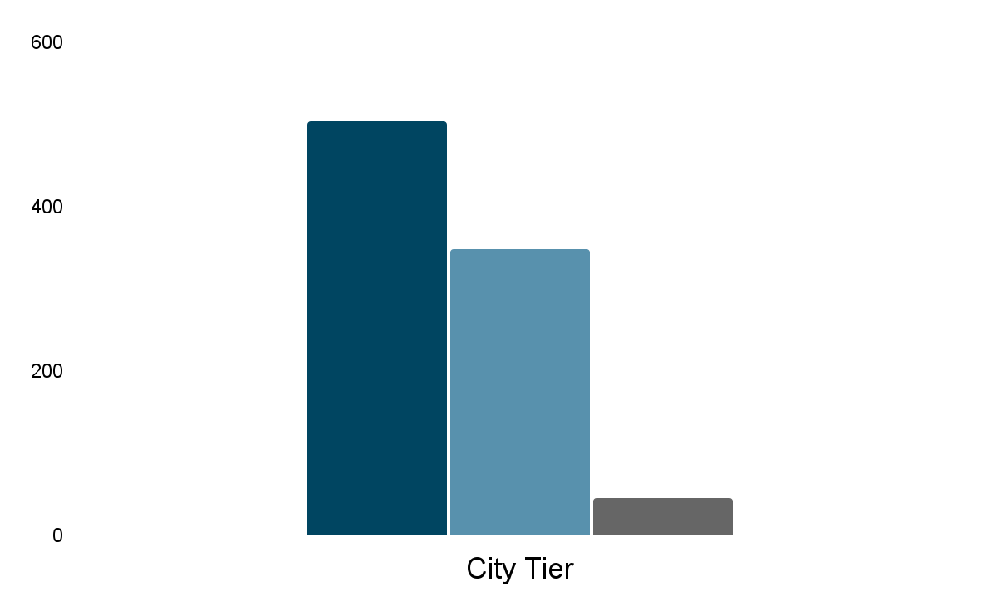
Product Taken Customer Behavior
Average Monthly Income
Age 22 - 55 years old
13.9%
Unmarried
18.9%
Single
47.9%
Married
$20,000 - 22.000
19.3%
Divorced
1
56%
Number of Follow Ups
3 - 5 times
3
39%
2
5%
Business Insight
40%
60%
Female
Male

Slide 15
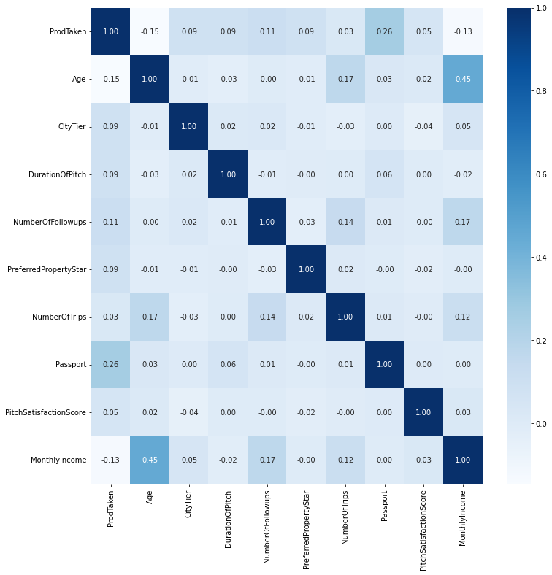
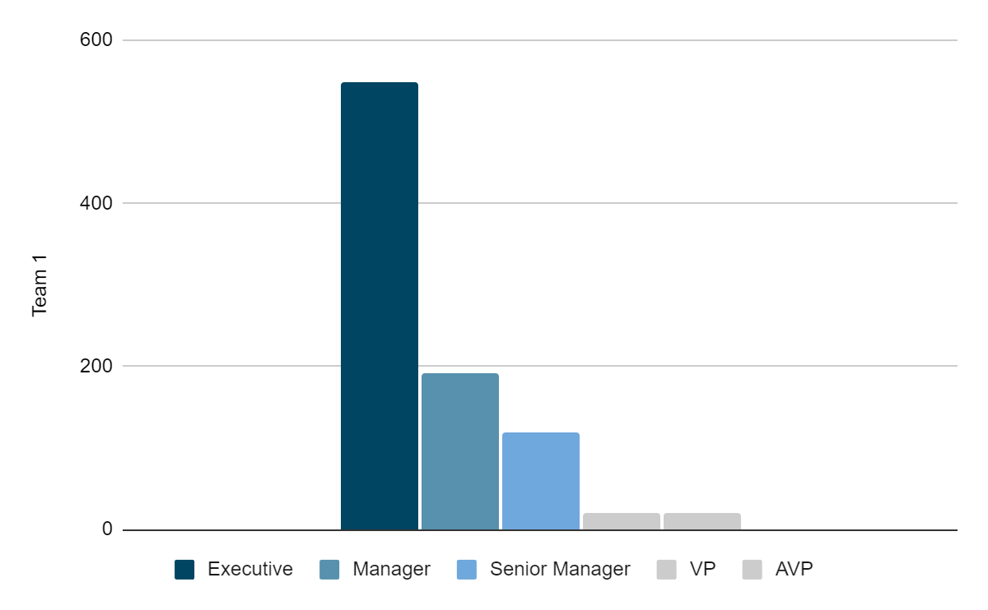
Feature Correlation
Standard
Basic
Deluxe
King
Super Deluxe
Business Insight
Notes:
Tiap paket targetnya tertuju sama 1 designation
Jelasin korelasi antar heatmap kalo yg paling kuat di Age dan Monthly Income

Slide 16

Modeling & Evaluation
03

Slide 17
Train – Test Split
Ratio 3:1 for modeling
Class Imbalance
SMOTE Method with ProdTaken 0 and 1 become 2591 : 2591 (1:1)
Logistic Regression
K Nearest Neighbor
Decision Tree
Random Forest
With Hyperparameter Tuning
Adaboost
XGBoost
Stacking
Modeling
Evaluation
Accuracy | Recall | Precision
F Score | ROC-AUC
Modeling & Evaluation

Slide 18
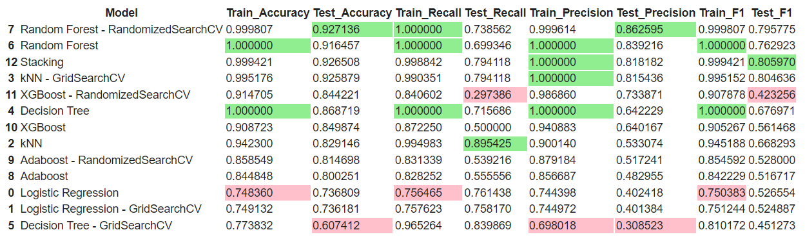
Confusion Matrix Analysis will be carried out for top 3 modeling
Modeling & Evaluation

Slide 19
Top 3 Modeling
Confusion Matrix
Model | True Positive | True Negative | False Positive | False Negative
Random Forest - Hyperparameter Tuning | 14.20 % | 78.52 % | 2.26 % | 5.03 %
Random Forest | 13.44 % | 78.52 % | 2.58 % | 5.78 %
Stacking | 15.08 % | 77.45 % | 3.33 % | 4.15 %
Modeling & Evaluation

Slide 20
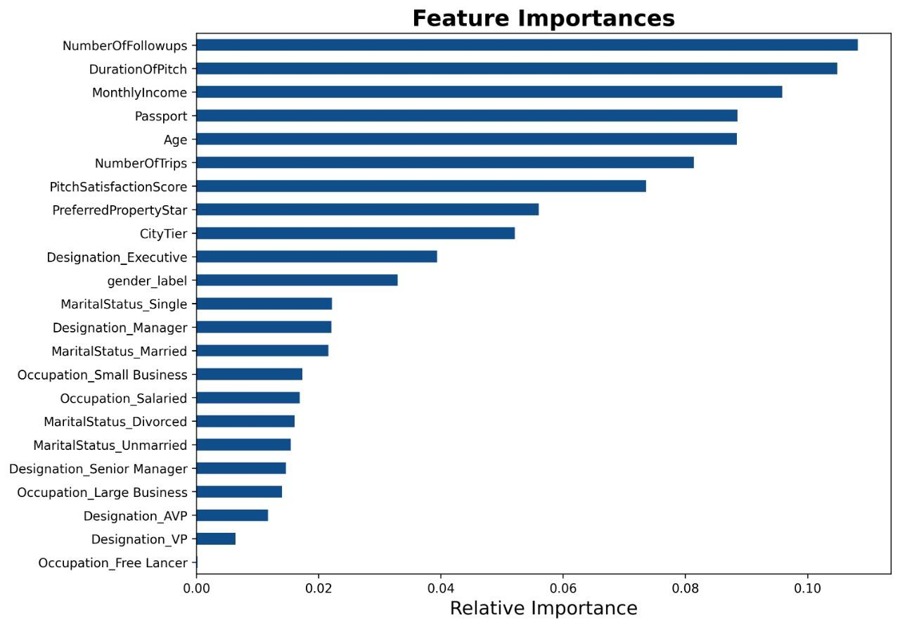
Feature
Importance
Modeling & Evaluation

Slide 21
Business Recommendation
04

Slide 22

Business Recommendation
For Sales Team:
The effective Number of Follow Ups is 3 - 5 times with Duration of Pitch 9 - 22 minutes
Provide additional services for making passport
Wellness Tourism
Basic
Standard
Customer Segmentation
28 – 41 years old
Single & Married
Male
City Tier 1 and 3
Salaried
Executive
18000 – 23000 USD
26 – 37 years old
Single
Male
City Tier 1
Salaried
Executive
17000 – 21000 USD
32 – 44 years old
Married
Male
City Tier 3
Small Business
Manager
20000 – 24000 USD
Business Recommendation
NEW PACKAGE

Slide 23
Business Recommendation
Customer Segmentation
Deluxe
Super Deluxe
King
32 – 44 years old
Married
Male
City Tier 3
Small Business
Manager
20000 – 24000 USD
40 - 45 years old
Single
Male
City Tier 3
Salaried
AVP
28000 - 31000 USD
42 -56 years old
Single
Female
City Tier 1
Small Business
VP
34000 - 38000 USD
Business Recommendation

Slide 24

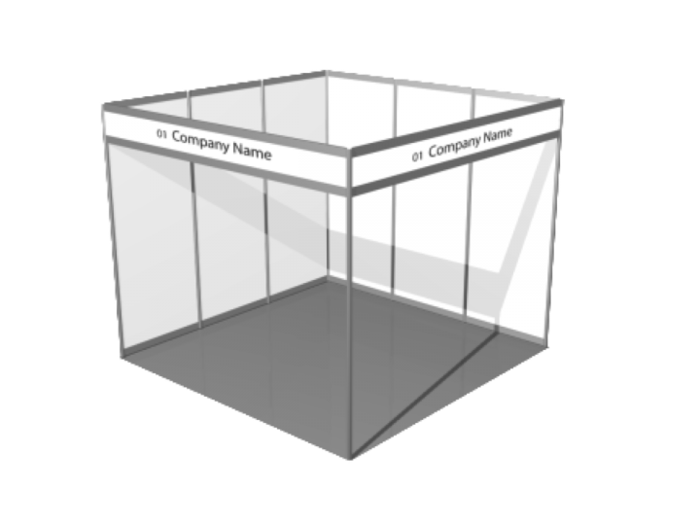


Business Strategy
Product Proposal
Optimize Social Media
Actively Join Exhibition
Instagram (Target Age: 26-30)
Youtube (Target Age: 26 - 35)
Facebook (Target Age: 30-56)
Email Marketing
Actively offer Proposal Business, specially before holiday.
Promotion time for those who are already married: on long holidays (eg Eid or Christmas)
If single, offer product after peak season
Actively join family travel Exhibition
Business Recommendation
Notes:
Sumber: https://khoros.com/resources/social-media-demographics-guide

Slide 25
Data Pengguna Medsos
Age
86% of people ages 18-29 use Facebook
77% of people ages 30-49 use Facebook
51% of people ages 50-65 use Facebook
34% of people that are 65+ years old use Facebook
Income
85% of households with an annual income of less than $30,000 use Facebook
88% of households with an annual income between $30k-$60k use Facebook
81% of households with an annual income between $60k-$70k use Facebook
88% of households with an annual income between $70k-$80k use Facebook
86% of households with an annual income between $80k-$100k use Facebook
86% of households with an annual income above $100,000 use Facebook
Age
67% of people ages 18-29 use Instagram
47% of people ages 30-49 use Instagram
23% of people ages 50-64 use Instagram
8% of people that are 65+ years old use Instagram
Income
44% of households with an annual income of less than $30,000 use Instagram
45% of households with an annual income between $30k-$60k use Instagram
36% of households with an annual income between $60k-$70k use Instagram
55% of households with an annual income between $70k-$80k use Instagram
46% of households with an annual income between $80k-$100k use Instagram
60% of households with an annual income above $100,000 use Instagram

Slide 26
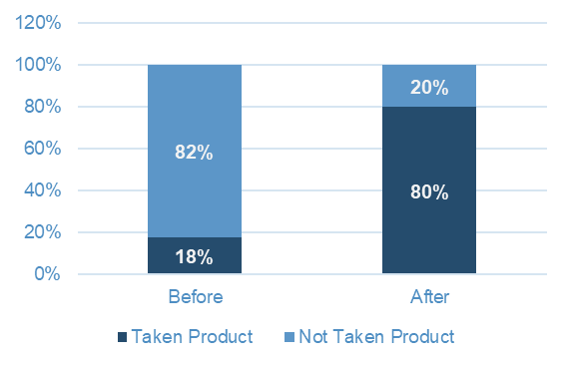
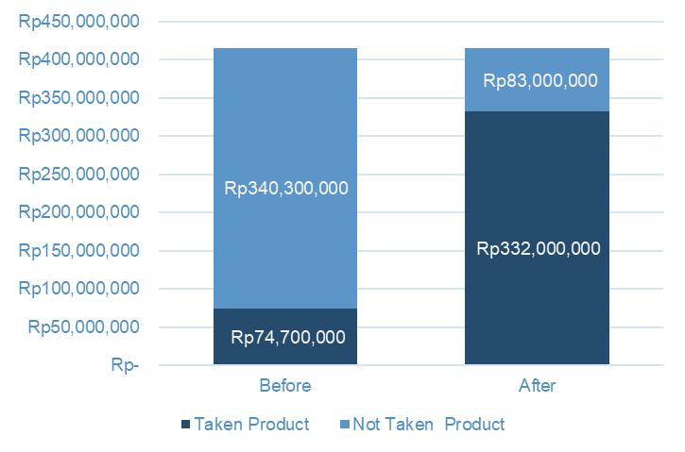
Product Taken Simulation
Bali Tour Packages 5 Days and 4 Nights Tours Price :
Price With Hotel : IDR 4.150.000 / person
https://www.baligoldentour.com/bali-tour-packages-5-days-4-nights.php
Before modeling: 18% (18 of 100 person) customer taken product: # Customer = 100 ProdTaken = 18 Revenue = 18 x Rp.4.150.000 = Rp. 74.700.000
After modeling: Precision 86%, we choose 70-80% of 100 customer taken product: # Customer = 100 ProdTaken = 70 Revenue = 70 x Rp.4.150.0000 = Rp. 290.500.000 ProdTaken = 80 Revenue = 80 x Rp.4.150.0000 = Rp. 332.000.000
Sales Increase 288 - 344%
Business Recommendation

Slide 27
Executive Summary
Project Background
82% customer not taken holiday packages because they were contacted randomly, so we need to increase sales of Trips & Travel.Com Holiday Packages with:
Create system to predict potential customer to support Wellness Tourism Package sales
Determine customer segmentation of the available packages
Implement new marketing strategies
Data Preparation
Data cleansing, feature selection, handle outliers, feature engineering & normalization
11 Models tested with Precision as Evaluation Target to reduce False Positive. Turns out smallest False Positive goes to Random Forest - Hyperparameter Tuning model with 2.26% and Precision 86%
Modeling & Evaluation
Business Recommendation
For Sales Team:
The effective Number of Follow Ups is 3 - 5 times with Duration of Pitch 9 - 22 minutes
Provide additional services for making passport
For Marketing Team:
Contact customer by their behavior of segmentation of packages
Product Taken Simulation
Sales increase about 288 - 344%
Business Recommendation

Slide 28
Pembagian Tugas
Pembagian Presentasi
Talenta Nanda : Project Background, EDA, Modeling & Evaluation
Dwirany Dian : Project Background, Modeling & Evaluation, Business Recommendation
Mega Dwi Astuti : Data Preparation, EDA, Modeling & Evaluation, PPT
Ichwan : Data Preparation, EDA, Business Recommendation
Avinska Valeria : Project Background, EDA, Business Recommendation, PPT
Talenta Nanda : Modeling & Evaluation
Dwirany Dian : Data Preparation
Mega Dwi Astuti : Business Recommendation
Ichwan : Project Background
Avinska Valeria : Data Preparation

Slide 29
Thank you
By Power Rangers

